Slide 1



BI PROJECT TCBDA14
Happy Insurance LTD
TALYA DAVID 066092370
EINAT TEPPER 032291999
SIVAN LITVAK, 065976029

Slide 2
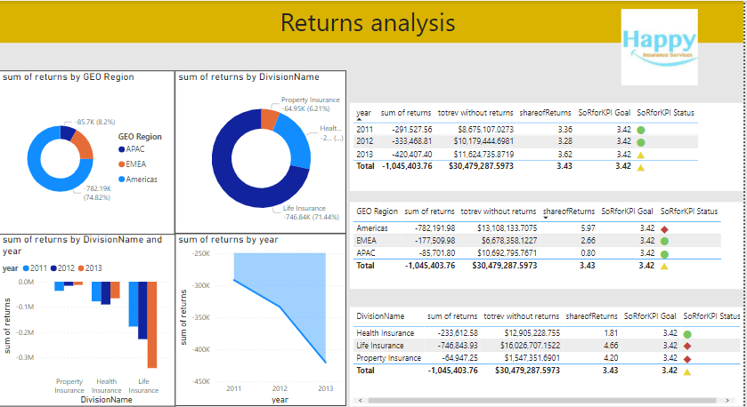
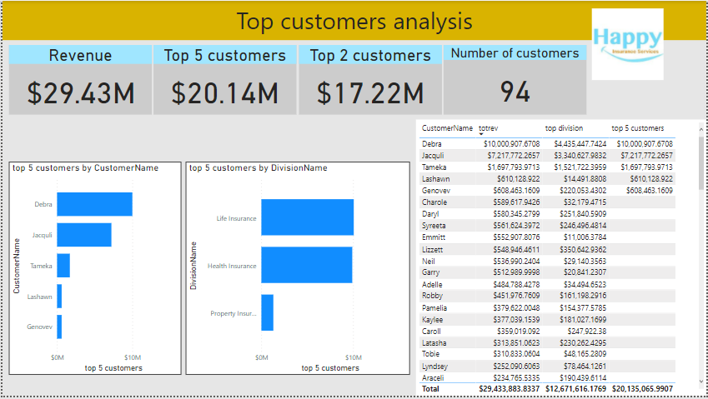
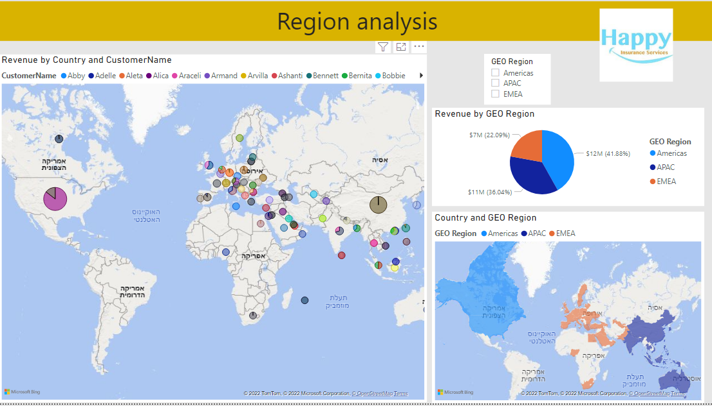

Milestones
SQL server
Excel
Power Query
(Dim, Fact tables )
Power Pivot
Star scheme
Power BI

Slide 3
Assumptions
Negative revenue is refund to the customer.
Happy insurance started to be active in 2011.

Slide 4
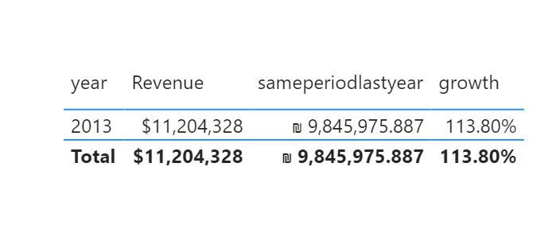
Problems
Problem | Solution
Duplicate rows appeared in the fact table | Not to create column Quarter and year in Dim Date merged with the fact table. The solution is to merge the column (imported from the orders table to the fact) to the existing DateKey in Dim Date (already created)
Part of the data was displayed in ILS currency and other were displayed in USD | Define the measure currency to dollar (USD)
One of the Dim tables did not load | Enter Power Query from the Power Bi interface → change the setting of the same table that was not loaded → Right click → enable data

Slide 5
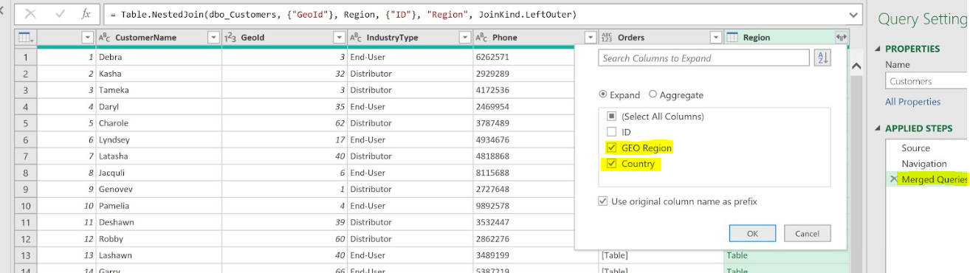
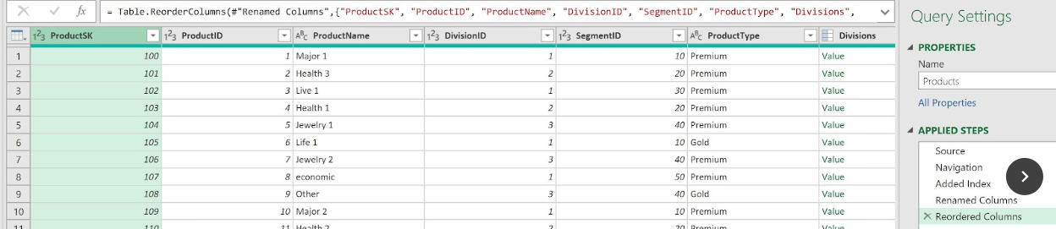
The process- screen shots: Setting the data
Merge
Creating SK
The process

Slide 6
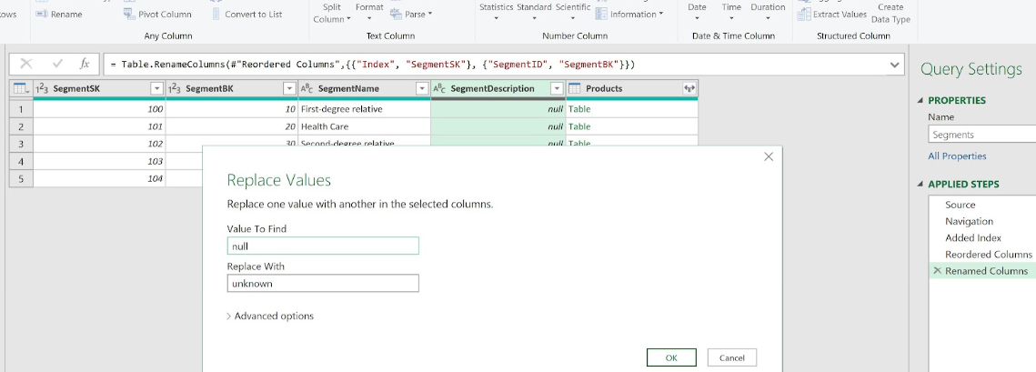
NULL handling
The process

Slide 7
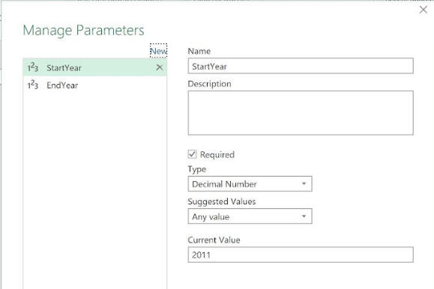
Dim date
Create parameters -
StartYear
EndYear
The process

Slide 8
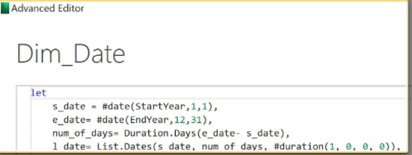
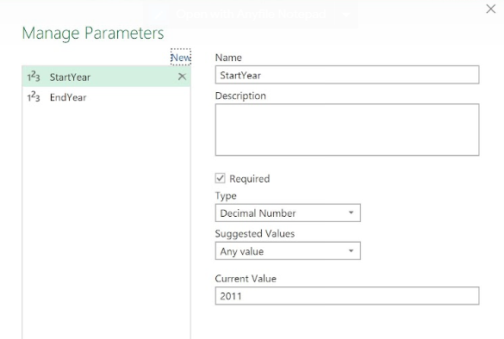
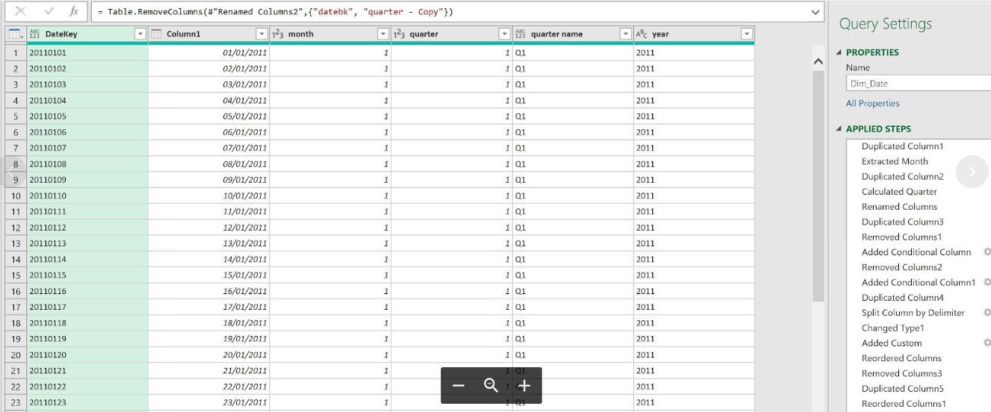
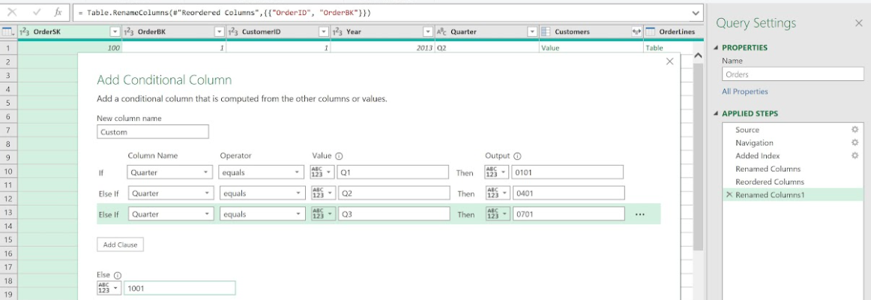
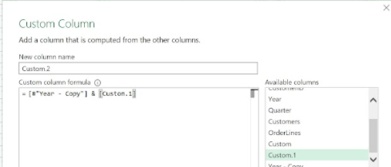
Implement Dim Date with M language
Arrange the data
The process

Slide 9
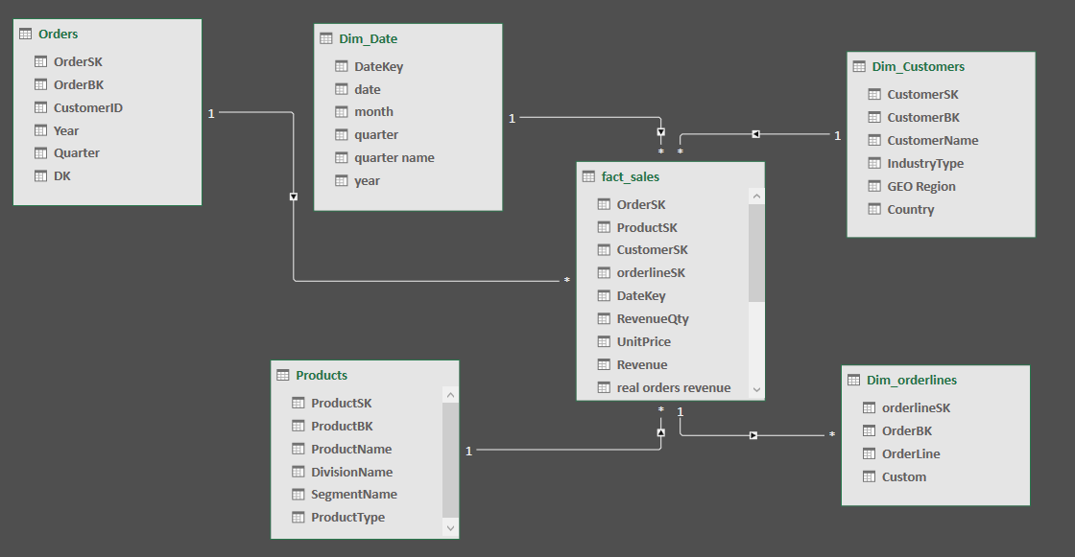
creating Star scheme

Slide 10
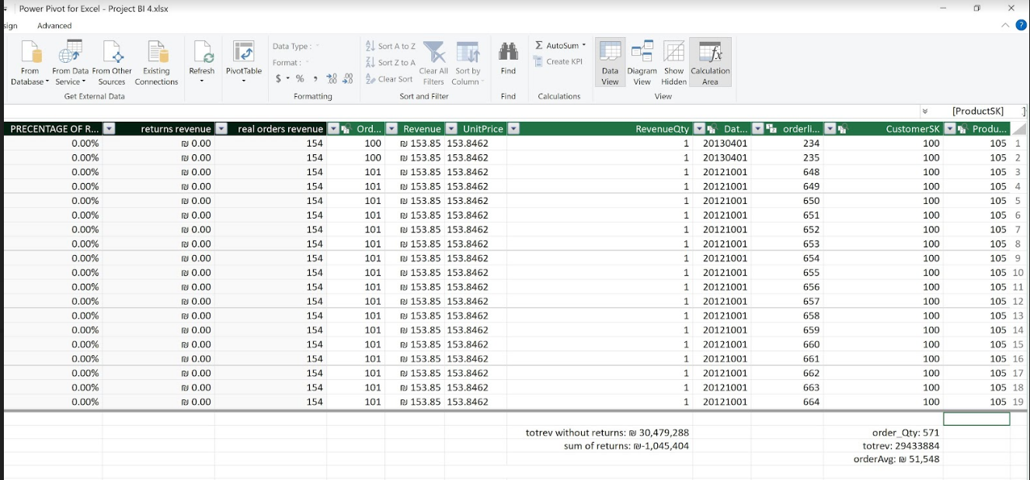
Creating measures in Power Pivot
The process

Slide 11
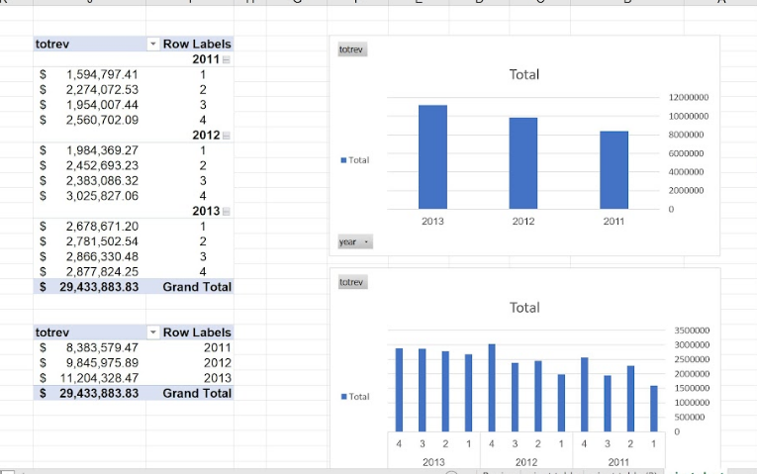
Creating pivot tables and pivot charts
The process

Slide 12
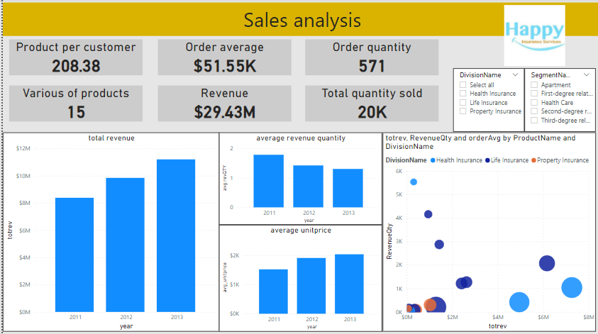
Sales analysis
In years 2012 and 2013
orders quantity and the various of products per customer decreased
but
but the order average has consistently grown.
This is because the average unit price has continuously grown between 2011-2012 and 2012-2013.
The effect is that in 2012 the revenues were higher than the 2011 revenues, although less products were sold

Slide 13
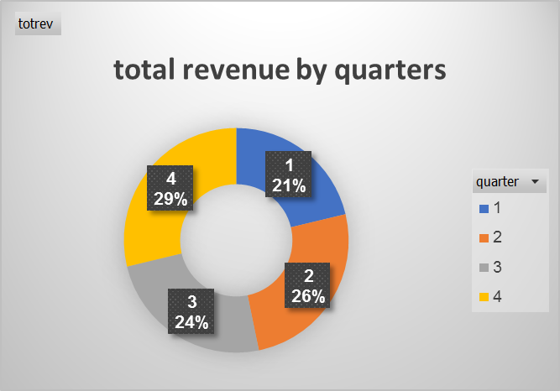
Quarters
There is a slight advantage to 4th quarter . but it is very small and insignificant.
It might be affected from the sells of the closing year events.

Slide 14
Region analysis

Slide 15
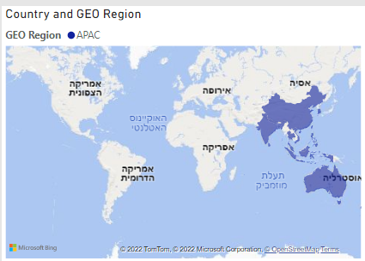
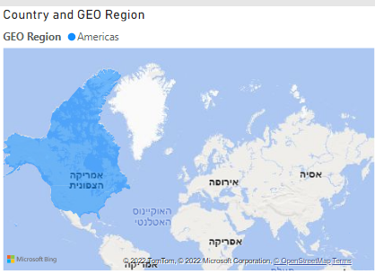
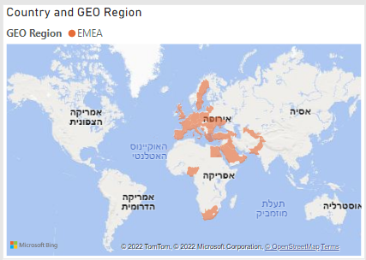
The American market comprises only 2 countries (with vast majority of activities in the USA)
The APAC market is comprised of relatively high geographically dispersed – with each country has about 7% market share.
In EMEA the diversity is the largest, where each country holds less than 2% of market share.
On the one hand, the spread of revenues makes the revenue flow more stable and resistant to local risks as political, military, local economy etc’.
On the other hand, the operative complexity is significantly higher - more local resources and employees are required – higher operational costs should be assumed which lowers the profitability of the region
VS.

Slide 16
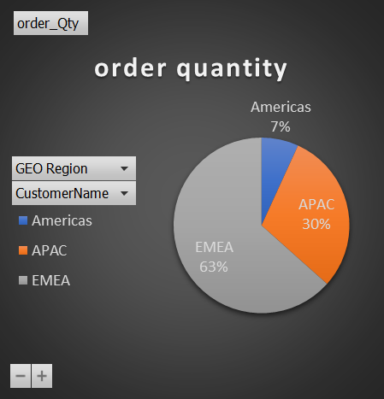
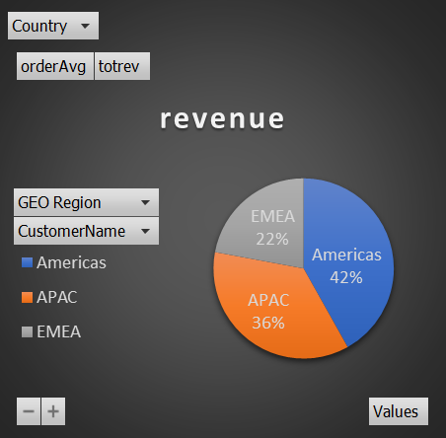
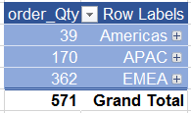
Region analysis
The American market is only 7% of the order quantity however this market is responsible for 42% of the total revenue.
The Vast majority of the revenues is derived from the Americas and APAC. While the total America's orders is 39, APAC's customers ordered 170 orders. That means that the order average of the America's customers is significantly bigger

Slide 17
Top customers analysis
The Top five customers (there are 94 customers with orders) are responsible for 20 million dollar of the total revenue that sums at 29 million dollar. That means happy insurance company id reliable on those 5 customers.

Slide 18
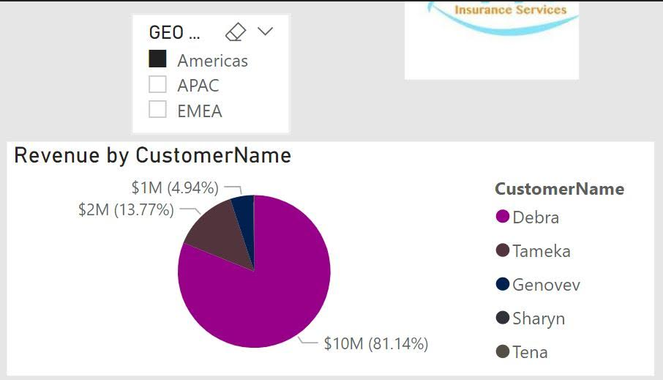
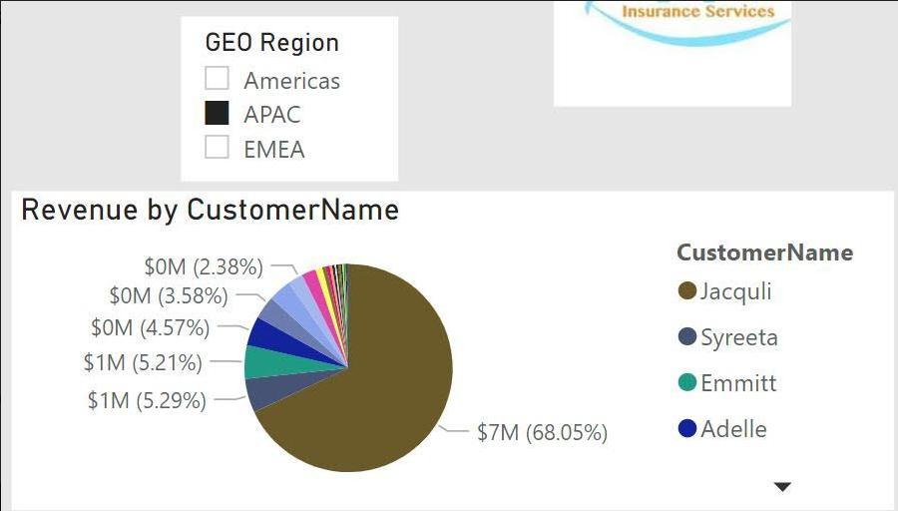
Top 2 customers
In the Americas the biggest customer is Debra and she is responsible for about 81% of each year revenues from this region.
In APAC the biggest customer is Jackuily and she is responsible for about 68% of the yearly revenues from this region.
Losing one or more of those 2 customers can bring Happy Insurance to insolvency in a flash.

Slide 19
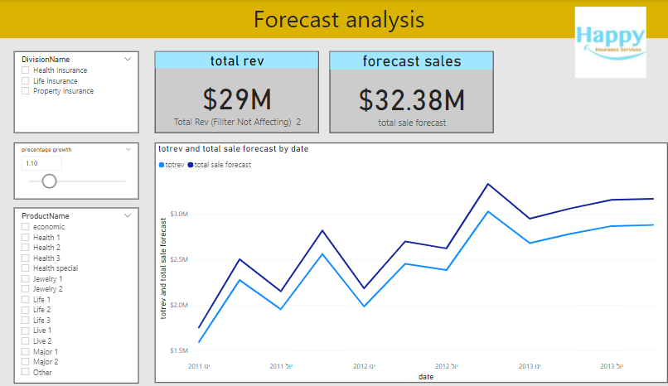
Forecast analysis
Using “what if” to show target of percentage growth .

Slide 20
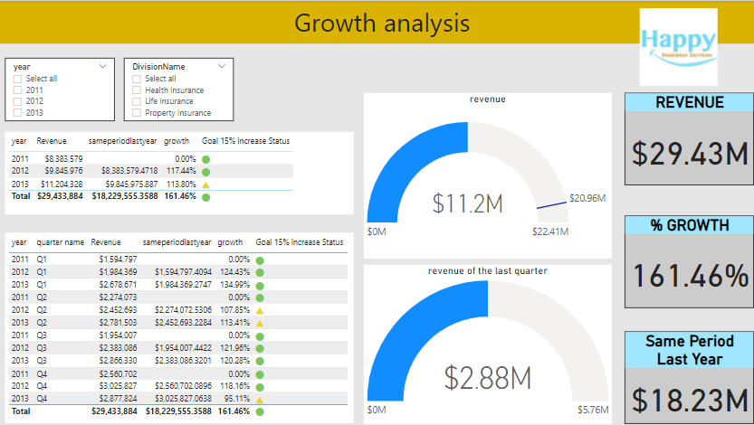
Growth analysis
Creating KPI to show hands on target.
Target - 15% increase of sales.

Slide 21
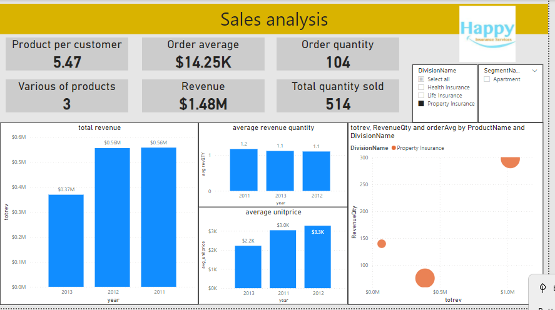
Division analysis- Property Insurance division
The property insurance is the least lucrative division.
The total revenues from this division is only 1.48 M$ for all 3 years.
Both unitprice and quantity of sales decreased for this product***
***
 | 2011 | 2013
Unit price$ | 3,037 | 2,224
Average amount sold K$ | 14 | 11

Slide 22
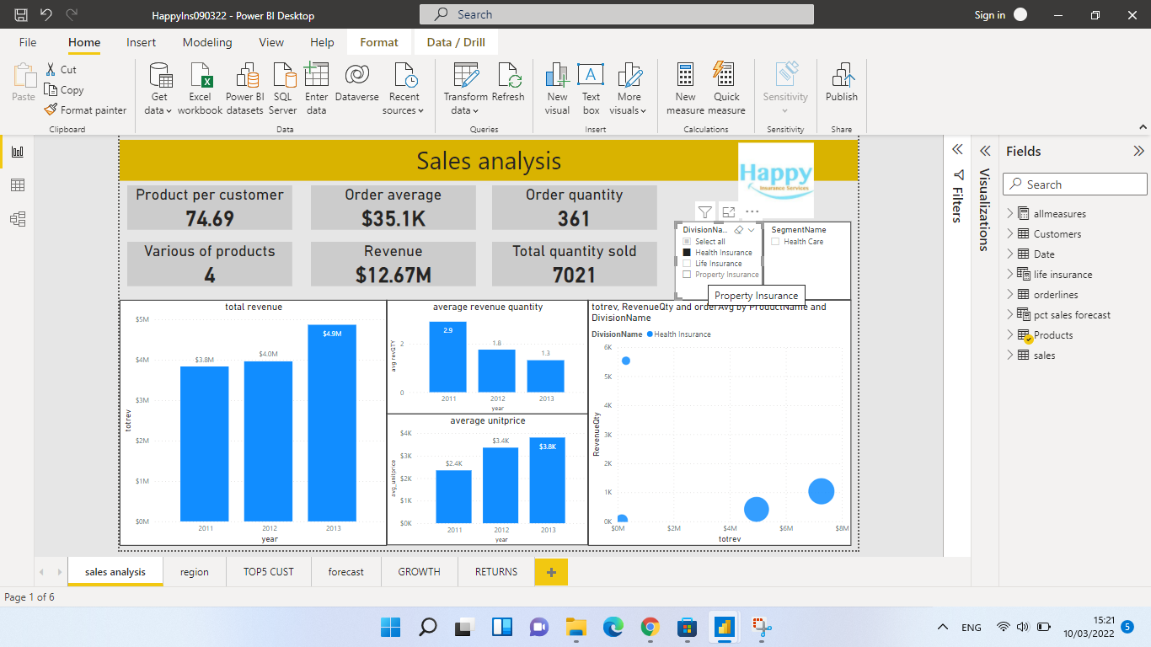
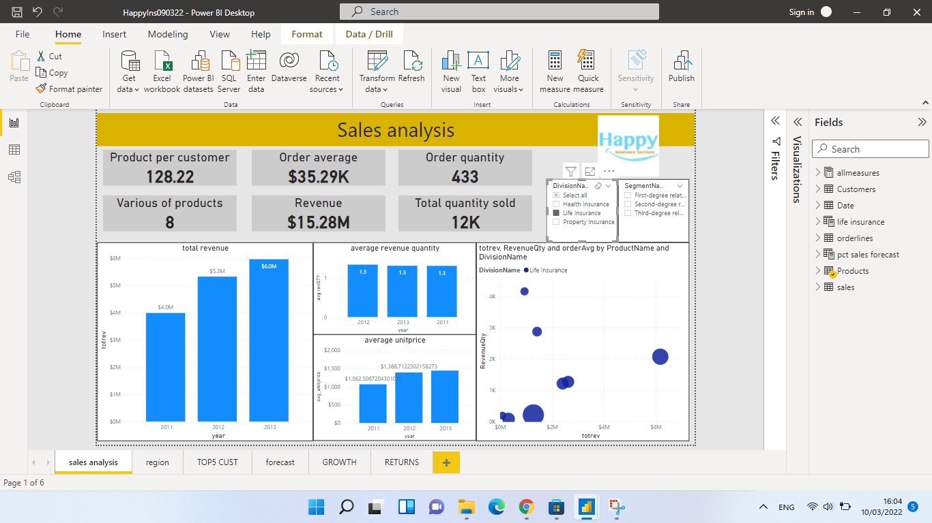
Division analysis-
Life and Health insurance divisions
While the revenues in both life and health insurance are consistently increasing, it seem that Happy insurance is reducing the property division.

Slide 23
Division analysis- Health Insurance
In the health insurance division the order average is the largest due to the expensive unit price in this division. Which means that few orders are responsible for the good revenue.

Slide 24


Slide 25
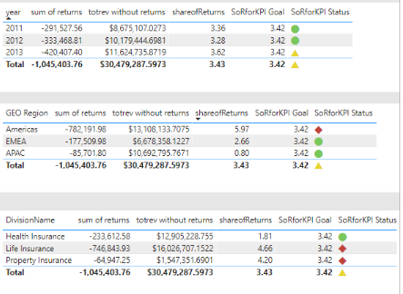
Returns analysis
KPI was created. The goal was defined as 3.42% (average of returns in the last 3 years + 10% = 4.1%)
Less than 3.42 < Green
Greater than 4.1 > Red
Between - Yellow
Returns – over the years 2011-2013 the share of returns out of the revenues is basically constant at approx. 3% and relatively low – a vote of confidence of the company’s customers.
It is possible that dividing the revenues into geographic segments reveals the cultural differences between the customers regions:
while in APAC the customers do not tend to return their purchases (0.8%), customers in the America’s are more picky and tend to return more orders – (6%) (EMEA Customers are somewhere in between, with a share of returns of 2.7%.
An alternative reason for the differences in share of return can be the diligent work of the company’s employees in APAC that make an effort to custom the right product to the costumers needs (there is not enough data to show the actual reasons for the share of return differences). Regarding the share of return in the product segments, it is clear that the rate of return is significantly lower in the Health division (1.8%) as on the other 2 divisions the rate is higher than 4%.
See previous slide

